Slide 1

B. Tech (Environmental Studies)
4th and 6th Semester
Global Warming and Climate change
Unit 6
Social Issues and the Environment
Prepared by; Dr Naresh Kumar Sahoo
Department: Chemistry
Subject: Environmental Studies (CHM1002)

Slide 2

Contents
Introduction of Global Warming and Climate Change
Causes of Climate Change
Working Principle of Green House Gases
Types, Sources, Level and Production of Green House Gases
Depletion of Stratospheric Ozone and Climate Change
Impact of Global Warming
Global Climate Change Model and Earth energy Budgets
Mitigation of Global Warming
Notes:
2

Slide 3
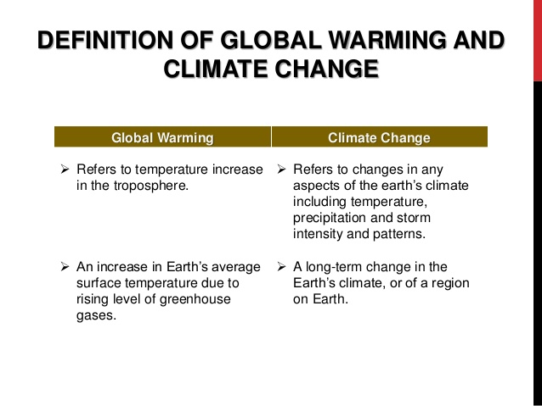
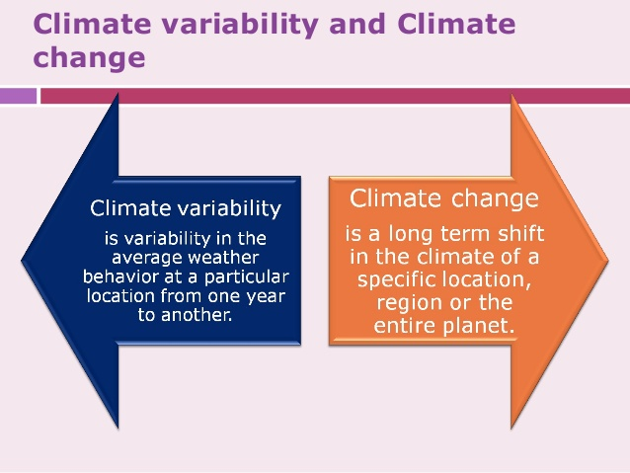

Slide 4
Causes of Climate Change
Feedback Mechanisms
Anthropogenic Global Warming
Bio-thermostat
Variations in Solar Radiation
Solar Irradiance
Sunspot Activity
Earth-Sun Geometry (Milankovitch cycles)
Atmospheric Dust and Volcanoes
Distribution of Continents
Plate Tectonics
Mountain Building
Ocean Variation
Thermohaline Circulation

Slide 5
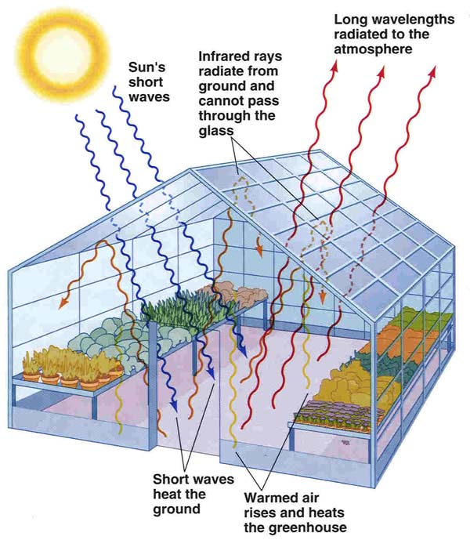
Anthropogenic Global Warming
Principle of Green House Gases ?

Slide 6
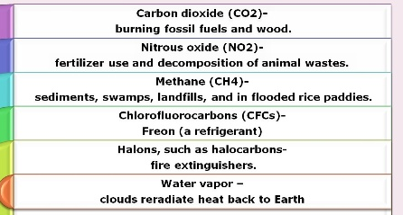
Type and sources Greenhouse Gases
        H₂O = 1-3%
        CO₂ = .035%
        CH₄
        N₂O
        O₃
        CFC’s
High
Conc.
Sources of ozone
Naturally occurring
Anthropogenic
Trace
Hydrofluorocarbons (HFCs), perfluorocarbons (PFCs) and sulphur hexafluoride (SF₆).
Sources of Green house gases

Slide 7
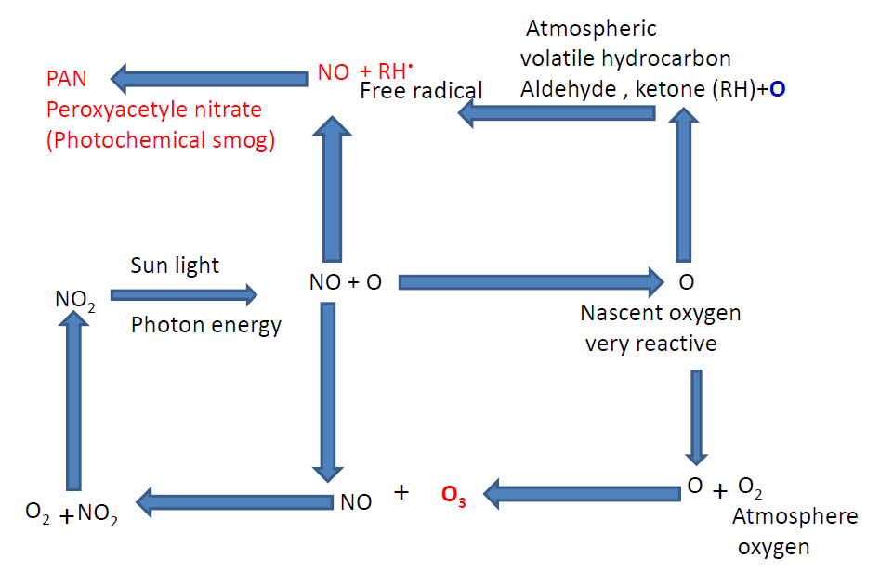
Photochemical Smog and formation of ground level Ozone

Slide 8
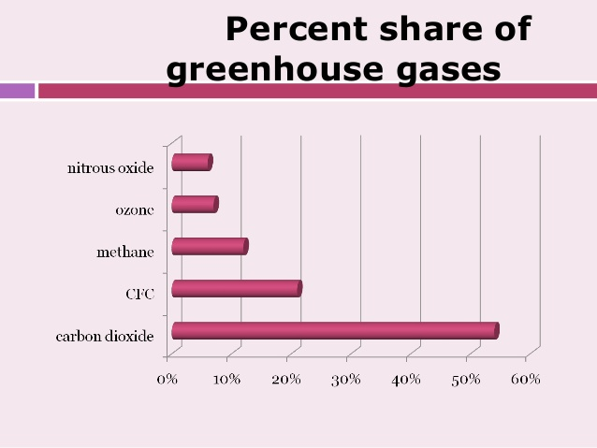

Slide 9
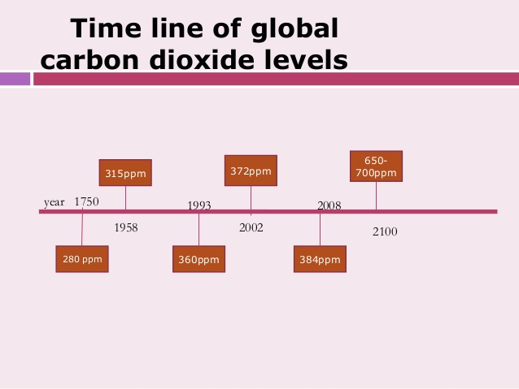

Slide 10
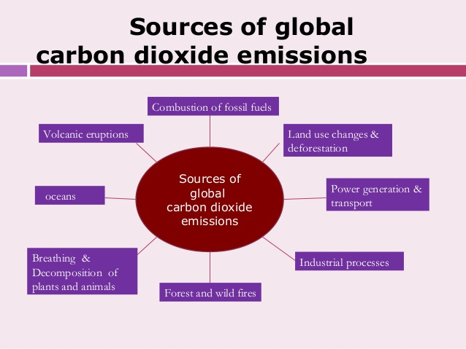

Slide 11
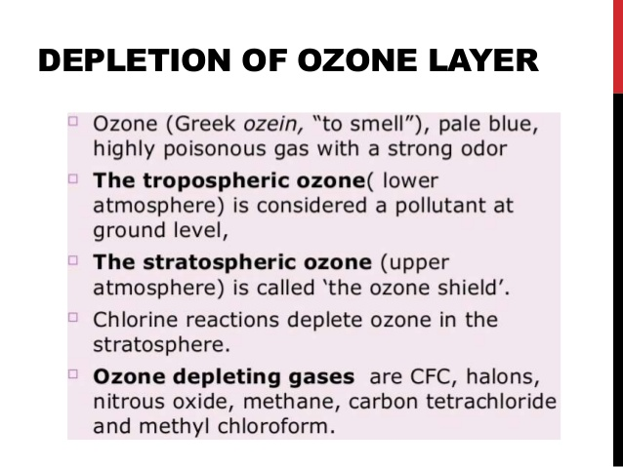
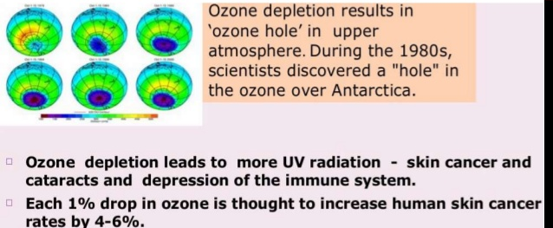
Depletion of Stratospheric Ozone and Climate change

Slide 12
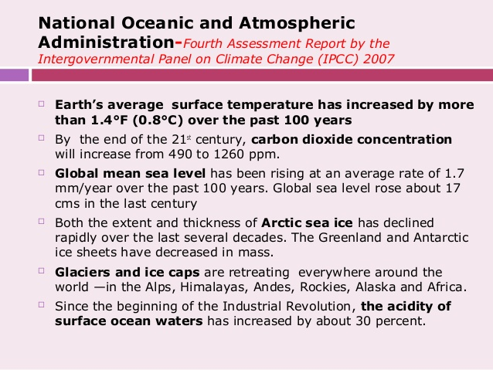
Impact of Global Worming
Influence amount and pattern of precipitation, Drought

Slide 13
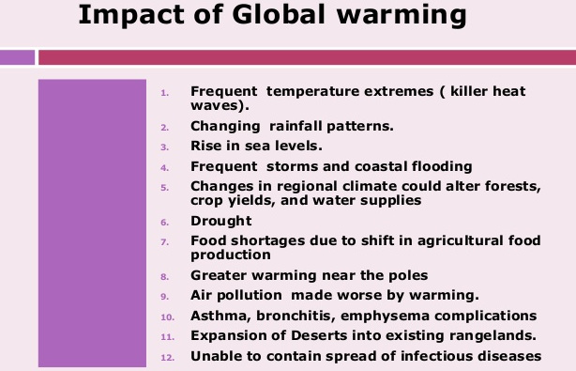

Slide 14
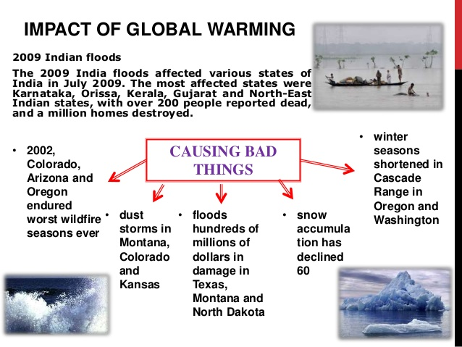
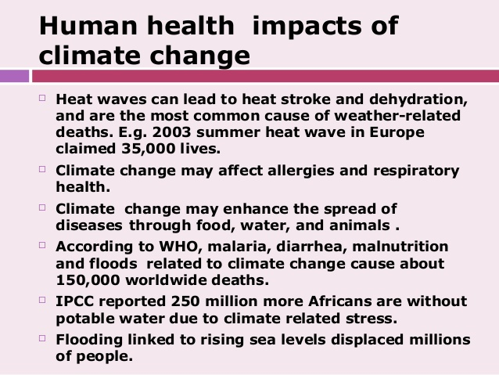

Slide 15
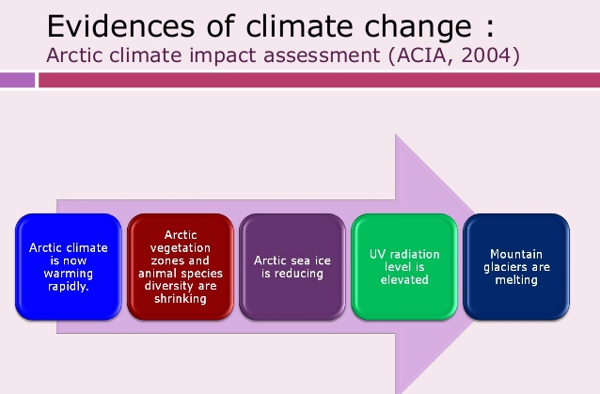

Slide 16
Earth energy Budgets

Slide 17
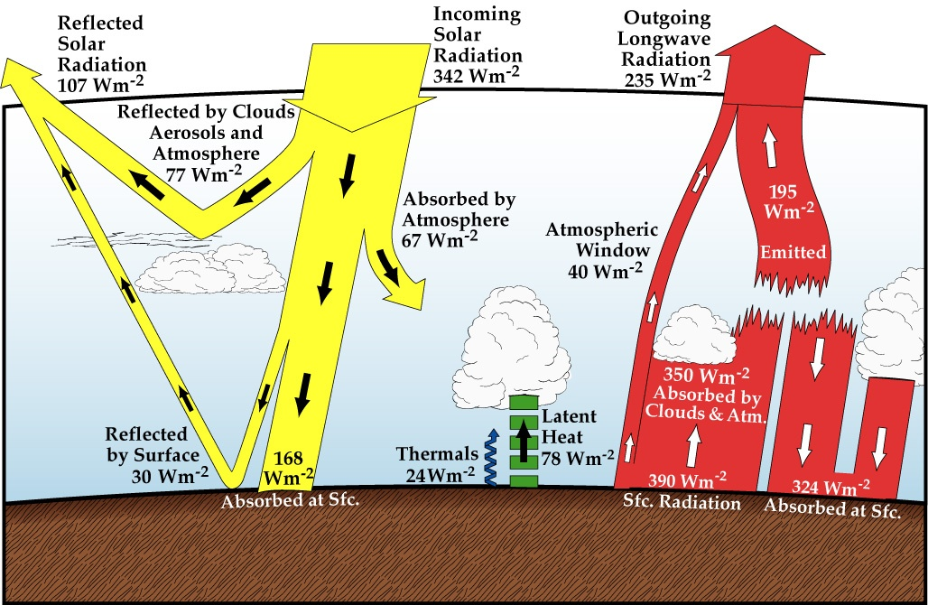

Pathways of energy transfer in a global
average
26 W/M2 lost to atmosphere
by convection of water
7-13 µm
Condensation of water vapor
26+24+78+40=168
168+67=235
Recap: Figure 2.8
Neelin, 2011. Climate Change and Climate Modeling, Cambridge UP
Notes:
global.energy.bal.clr.eps from chap2

Slide 18
Global climate change Model

Slide 19
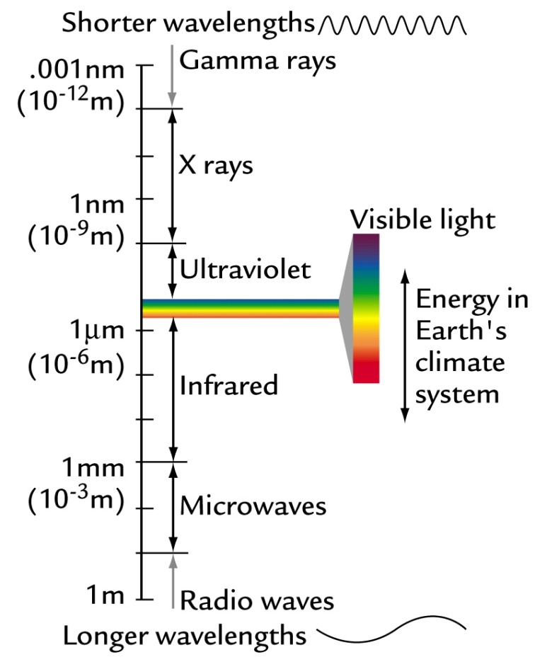
Black Body Radiation
A blackbody is something that emits (or absorbs) electromagnetic radiation with 100% efficiency at all wavelengths.
Blackbody radiation is the radiation emitted at a characteristic wavelength that depends on the body’s absolute temperature.
Wien’s Law - Peak wavelength emitted by a body
  λ_{peak} (in microns) = 2877/TK
For Sun:
  5780K = temp of photosphere
  λ_{peak sun} = 2877/5780
  = 497 nm
  = 4.97 x 10⁻⁷ m

Slide 20
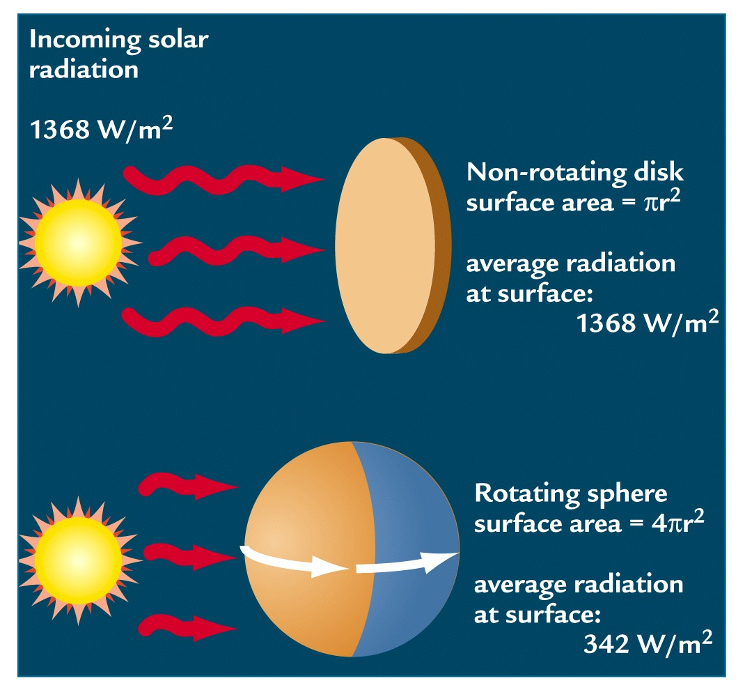
Solar Constant
Stephan-Boltzman Law (Energy emitted)
E = σT⁴
  = Stephan-Boltzman constant = 5.67 x 10⁻⁸ Wm⁻²K⁻⁴
E is proportional to the area under the Planck function curve
E_{sun} = 6.3 x 10⁷ W/m²
Only a small fraction of sun’s energy is received by the Earth

Slide 21
Earth
Incoming radiation is short wave.
Outgoing radiation is long wave.
If the Earth is a blackbody at steady state
  Incoming = outgoing
  Energy_{in} = Energy_{out}

Slide 22
Earth- Incoming Radiation
Solar radiation intersects Earth as a disk (πr²)
Energy_{in} = Energy_{in} from sun (S) – Reflected Solar Energy
  = πr² S - πr² Sα
  Where:
  r = radius of Earth (6360 km)
  S = solar constant (1368 W/m²)
  = albedo (earth’s reflectivity) (~30%)
  = πr² S (1- α)

Slide 23
Earth- Outgoing Radiation
Earth radiates as a sphere with area 4πr² (m²)
Stephan-Boltzmann equations defines outgoing energy based on radiating temperature
Energy_{out} = 4πr² σT_{e}⁴
  (units (m²)(Wm⁻²K⁻⁴)(K⁴) = W
  Total energy emitted by the Earth

Slide 24
Earth’s Radiation Budget
If the earth were a black body the in = out
Set incoming = outgoing
  πr² S (1- α) = 4πr² σT_{e}⁴
  Simplify:
  S/4 (1- α) = σT_{e}⁴
  Solve for T_{e}
  T_{e} = 255K (-18 °C)

Slide 25
Earth as a Black Body
Earth’s actual surface temperature
  T_{s} = 288K (15°C)
  λ_{peak} (μm) = 2877/288 = 10 μm (IR)
  T_{s} - T_{e} = 288 – 255 = 33
  = Earth’s natural greenhouse
Interactions within atmosphere alter radiation budget (Earth is not a black body)
Greenhouse Effect

Slide 26
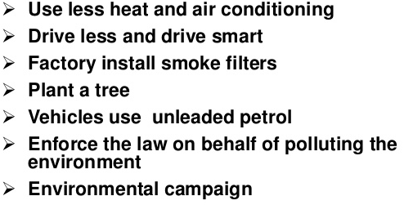
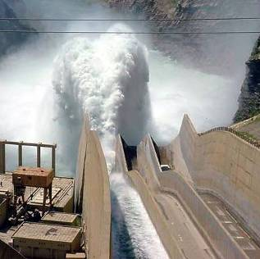
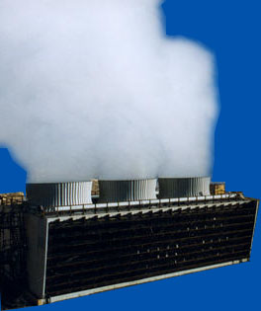
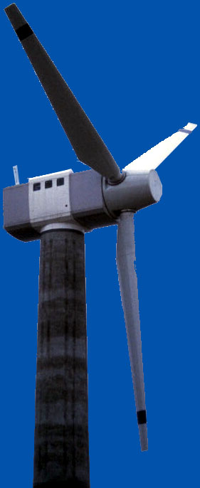
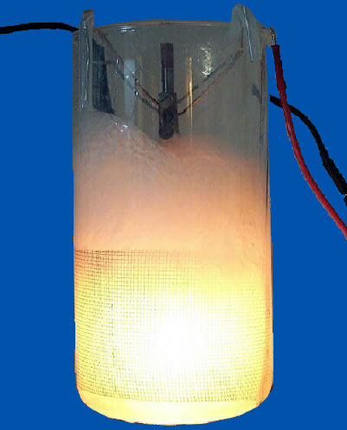
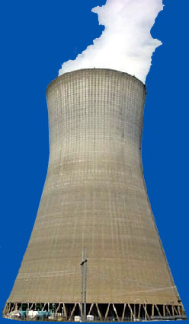


Mitigation of Global Warming
Conservation
  Reduce energy needs
  Recycling
Alternate energy sources
  Nuclear
  Wind
  Geothermal
  Hydroelectric
  Solar
  Fusion?
Notes:
Methods of mitigating global warming include 
Conservation 
Reduce energy needs, such as electrical usage, petroleum usage, reduced packaging 
Recycling, which uses less energy to produce products compared to 
Another way to reduce carbon emissions is to use alternate energy sources, such as 
Nuclear 
Wind 
Geothermal 
Hydroelectric 
Solar 
Fusion? 

Slide 27
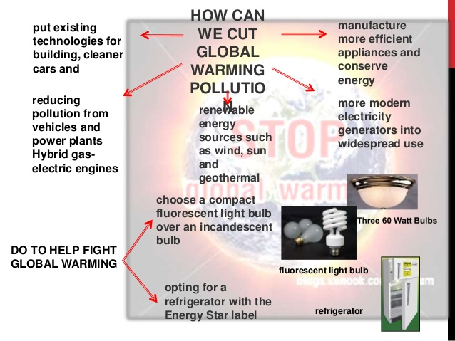

Slide 28
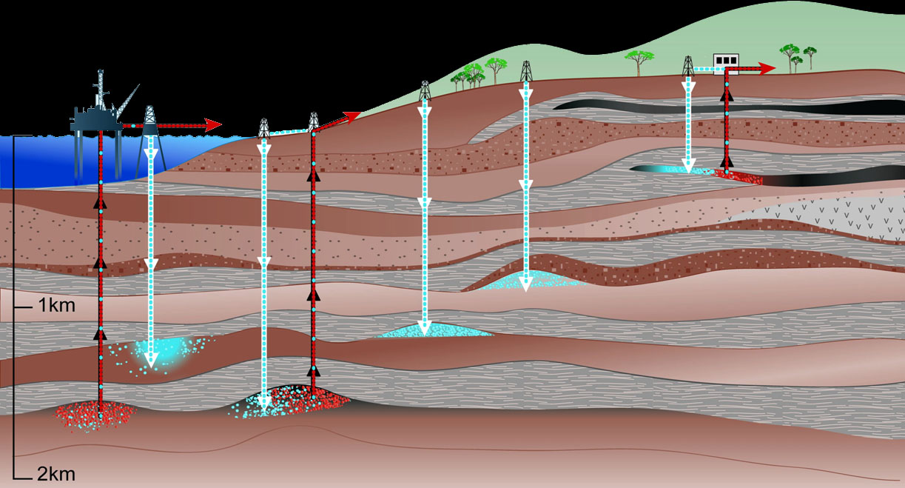
Storage of CO₂ in Geological Formations
Depleted oil and gas reservoirs
CO₂ in enhanced oil and gas recovery
CO₂ in enhanced coal bed methane recovery
1
4
3b
3a
2
Adapted from IPCC SRCCS Figure TS-7
Notes:
Another promising way to reduce global warming is to store carbon dioxide underground.  Carbon dioxide can be pumped into depleted oil and gas reservoirs.  In addition, carbon dioxide can be pumped into existing oil and gas deposits to enhance recovery. Another method  Carbon dioxide can also be used to enhance methane recovery from coal beds. 

Slide 29


